Slide 1
Computer Graphics 2D and 3D Transformation
Ms. Sonali Rokade

Slide 2
Points to be covered
3D Transformation
Projections

Slide 3
3D Transformation
It includes
1. Translation
2. Scaling
3. Rotation

Slide 4
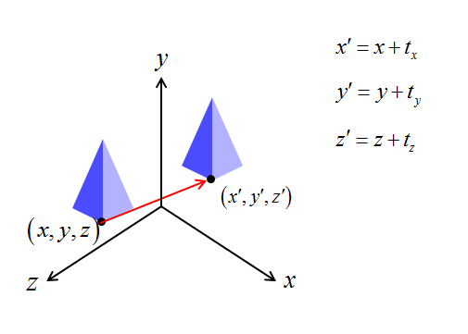
3D Transformation
It is very similar to 2D. Uses 4x4 matrices rather than 3x3 Matrices.

Slide 5
3D Transformation
Transformation Matrix in 3D
3×3 : Scaling, Rotation
1×3 : Translation
1×1 : Uniform global Scaling
3×1 : Homogeneous representation

Slide 6
3D Transformation
1. Translation
P’ = P x T
x’ = x + t_{x} , y’ = y + t_{y} , z’ = z + t_{z}
y
x
z

Slide 7
3D Transformation
2. Scaling
Uniform Scaling
P’ = P x S
x’ = x . s_{x} , y’ = y . s_{y} , z’ = z . s_{z}
y
x
z

Slide 8
3D Transformation
Scaling with a Selected Fixed Position
y
y
y
y
z
x
z
x
z
x
z
x
Original position
Translate
Scaling
Inverse Translate

Slide 9
3D Transformation
3. Rotation
Coordinate-Axes Rotations
X-axis rotation - P = R_{x}(θ) . P
Y-axis rotation - P = R_{y}(θ) . P
Z-axis rotation – P = R_{z}(θ) . P
General 3D Rotations
Rotation about an axis that is parallel to one of the coordinate axes
Rotation about an arbitrary axis

Slide 10
3D Transformation
Coordinate-Axes Rotations
X-Axis Rotation - Y-Axis Rotation - Z-Axis Rotation
y
y
y
x
x
x
z
z
z

Slide 11
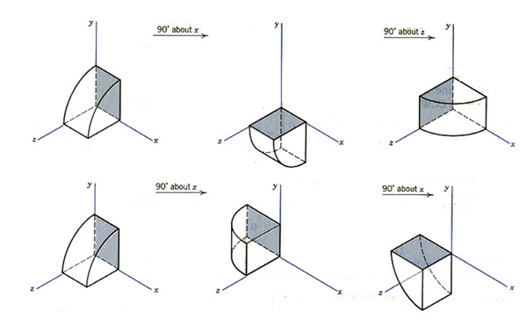
3D Transformation
Order of Rotation Affects Final Position
X-axis ➔ Z-axis
Z-axis ➔ X-axis

Slide 12
Projections
WHAT IS PROJECTION?
Projection can be defined as a mapping of point P(x,y,z) into its image P’(x’,y’,z’) in the projection plane which constitute the display surface.
In short it is the transformation of a three dimensional (3D) object into a two dimensional (2D) plane.

Slide 15
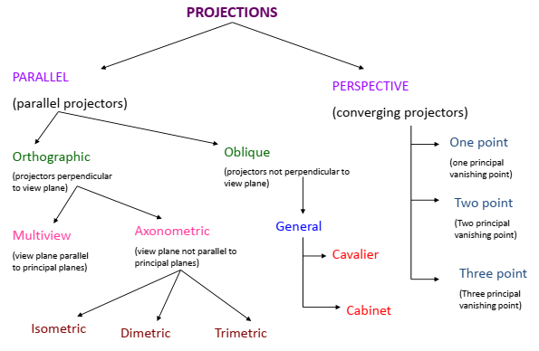
Projections
Classification of Projection

Slide 16
Projections
2 types of projections
Parallel
Perspective
In parallel projection, coordinate positions are transformed to the view plane along parallel lines.
In perspective projection, object position are transformed to the view plane along lines that converge to a point called projection reference point (center of projection) .

Slide 17
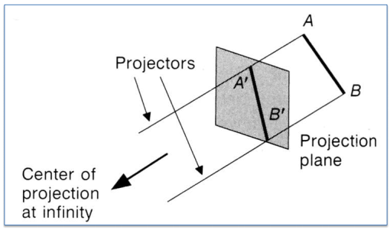
Projections
In parallel projection, coordinate positions are transformed to the view plane along parallel lines.

Slide 18
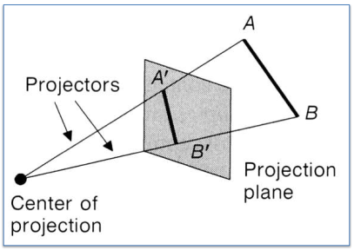
Projections
In perspective projection, object position are transformed to the view plane along lines that converge to a point called projection reference point (center of projection) .

Slide 19
Projections
Types of Parallel Projections
Orthographic Projection: when the projection is perpendicular to the view plane. In short, – direction of projection = normal to the projection plane. – the projection is perpendicular to the view plane.
Oblique Projection: when the projection is not perpendicular to the view plane. In short, – direction of projection normal to the projection plane. – Not perpendicular.

Slide 20
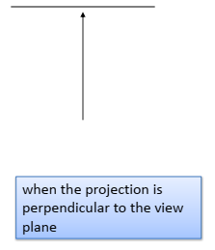
Projections
Orthographic Projection: when the projection is perpendicular to the view plane.

Slide 21
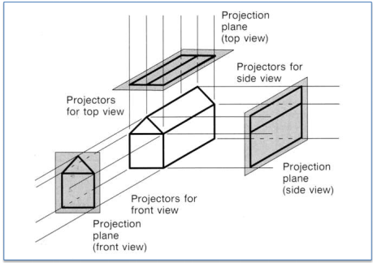

Slide 22
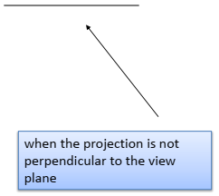
Projections
Oblique Projection: when the projection is not perpendicular to the view plane.

Slide 23
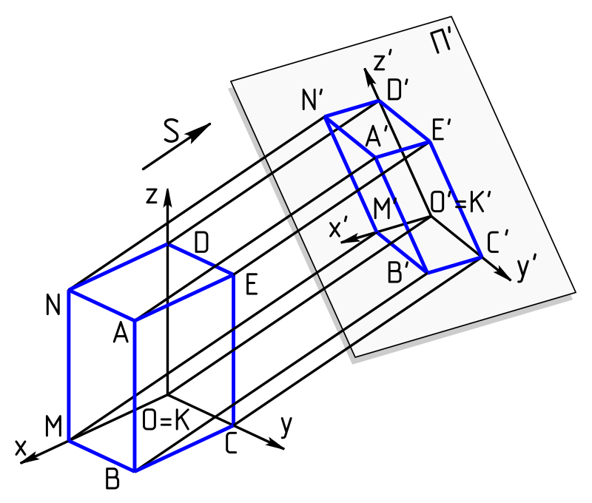

Slide 24
Projections
Orthographic projections are further classified as
Axonometric Projections
The projection which can display more than one face of an object is called as axonometric projection.

Slide 25
Projections
Axonometric Projection has 3 types
Isometric : All three principle axes are foreshortened equally.
Dimetric : Two principle axes are foreshortened equally.
Trimetric: All three principle axes are foreshortened unequally.

Slide 26
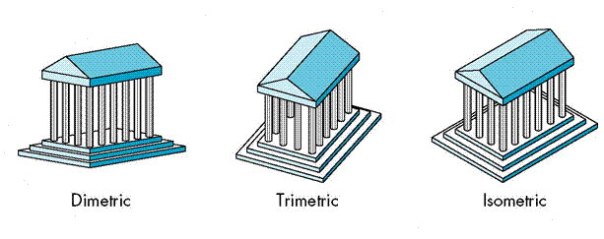
Projections

Slide 27
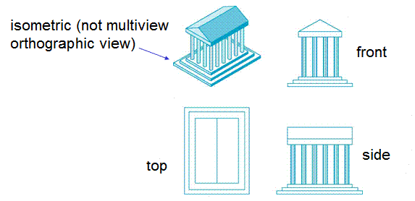
Projections
Multiview Projections
Projection plane parallel to principal face. Usually forms front, side or top view.

Slide 28
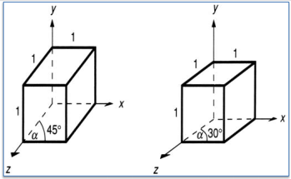
Projections
Oblique Projections are further classified as
CAVALIER:-In this projection lines makes angle of 30 degree with the view plane & there is no change in the length of projection.

Slide 29
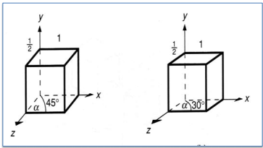
Projections
CABINET:-In this projection lines makes angle of 45 degree with the view plane & length of projected line will reduce.

Slide 30
Projections
Vanishing Point in Perspective Projection
The perspective projection of any set of parallel lines that are not parallel to the projection plane converge to a vanishing point.
The vanishing point for any set of lines that are parallel to one of the three principal axes of the object is referred to as a principal vanishing point or axis vanishing point.

Slide 31
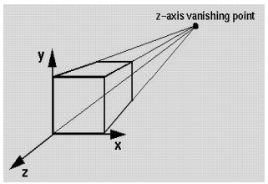
Projections
THERE ARE 3 TYPES OF PERSPECTIVE PROJECTION:
ONE-POINT PERSPECTIVE PROJECTION

Slide 32
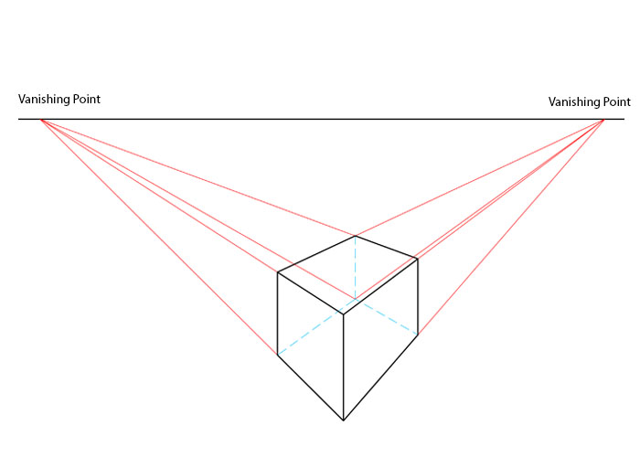
Projections
TWO-POINT PERSPECTIVE PROJECTION

Slide 33
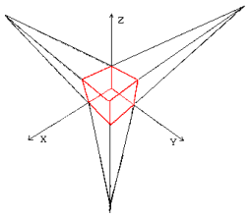
Projections
THREE-POINT PERSPECTIVE PROJECTION

